Slide 1
Chapter 9 – Unsupervised learning
Artificial Intelligence

Slide 2
Unsupervised learning
Finds patterns in data
Clustering customers by their purchases
Compressing data using these purchase patterns
Supervised: predict something
Will the student pass?
Is the transaction fraudulent?
Unsupervised: find patterns without a prediction task in mind

Slide 3
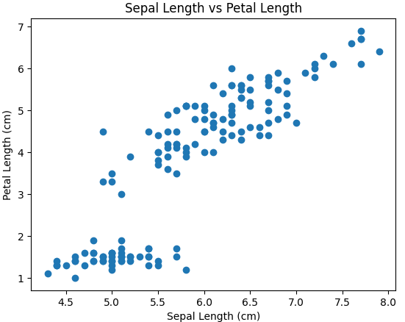
Unsupervised learning
What clustering does is best visualized in a 2D-scatterplot
We as humans can look at this and see 2 distinct groups
Unsupervised learning allows a model to do the same
But also in more dimensions, which is where things get difficult for humans

Slide 4
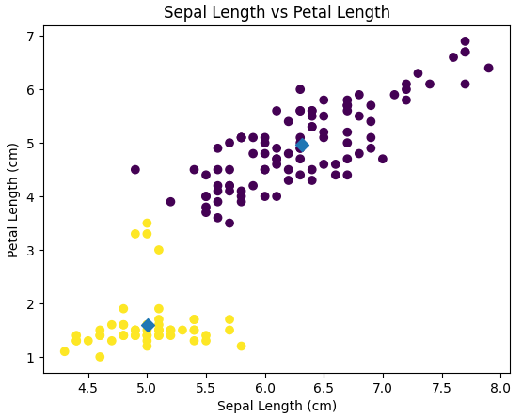
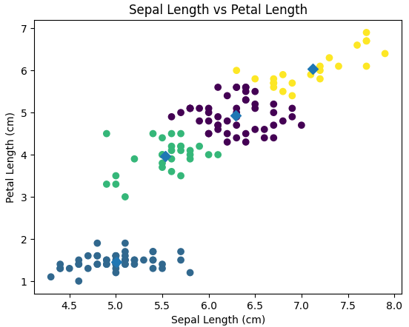
KMeans
If we train a Kmeans clustering model on this data, we get the two groups as in this graph
The blue diamonds are the centerpoints, all datapoints or divided based on their distance to these center points
We can tell the model how many groups we want it to make
It will make the most logical grouping based on that number

Slide 5
Inference
After training a supervised model you can do inference: apply the model to new, unseen data
This can also be done with an unsupervised model
It means that you provide new data to this model and the model decides which category the new data belongs to

Slide 6
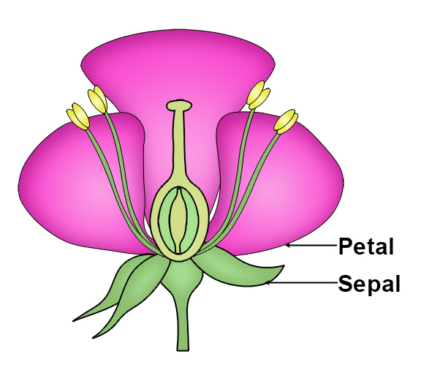
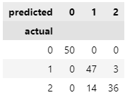
Predicting the Iris-dataset
The Iris-dataset is a dataset containing the with and length of de sepals and petals of three types of irises
What happens if we build a cluster on this, telling the model to create 3 groups in the data?
The model gets category 0 right
It has difficulty with the other two

Slide 7
Unsupervised?
But wait!
We’re predicting the type of iris-flower, and we’re not supposed to be predicting because we are doing unsupervised learning
So if we didn’t know how many types of irises there were in the dataset, how many groups would we have made?
For this, inertia can be used
It’s a measure for how far the datapoints are from the center of the cluster
Lower is better

Slide 8
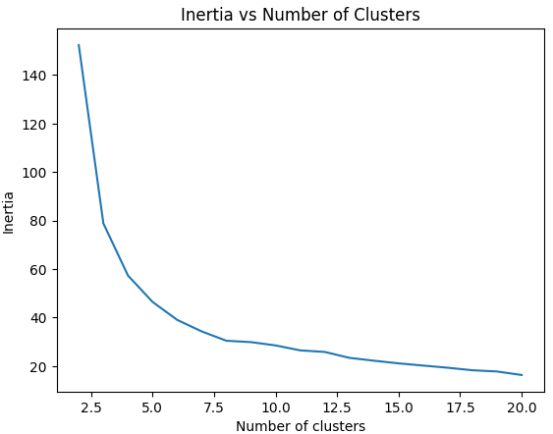
Inertia-plot
When creating models with more clusters, the inertia is definitely going down
But the decrease is much bigger in the beginning than it is at the end
Ideally speaking, you’d take the elbow as the amount of clusters you’ll make
In this case, that would be about 7
Elbow

Slide 9
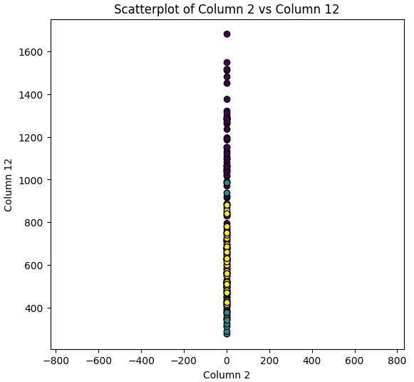
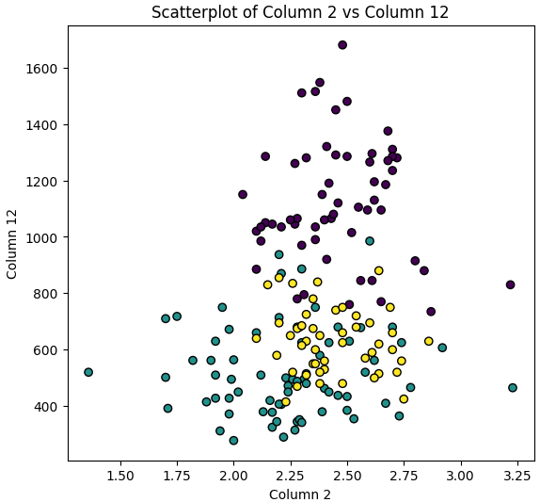
Scaling
If you consider these two scatter plots, you’ll find that doing clustering is easier in the bottom one than in the top one
They show the same data, but in the top graph both axis are scaled equally
KMeans uses a distance metric that is the same for all dimensions, which means it uses the top graph to do clustering
What does that mean for a model trained on this data?

Slide 10
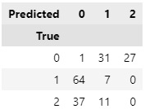
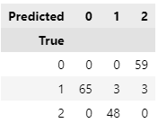
Scaling
It means the model will be bad:
Predicted 0 is mostly 1, but half the time it’s 2
Predicted 1 is mostly 0, but half the time it’s 1 or 2
Predicted 2 is always 0
To help the model, we have to scale the data
Make sure all values are between -1 and +1
The result?

Slide 11


Scaling
Scaling: The broader term for normalization and standardization
Normalization:
Min-max scaling
All values between 0 and 1
Sensitive to outliers
Standardization (Z-score normalization)
Uses mean and standard deviation
Good for normally distributed data
Preserves outliers
Notes:
https://www.geeksforgeeks.org/normalization-and-scaling/

Slide 12
Scaling
The downside to scaling is that the model expects scaled data, not the actual data
You have to rescale the ‘new’ data before you can reliably assess a grouping
But when rescaling we have use the same values as before

Slide 13
Summary
Unsupervised learning looks for clusters in your data
This can be done visually for 2D-data, but clustering can do the same in many dimensions
Clustering can be used to predict a grouping, turning it into a kind of supervised learning
When clustering make sure your data is standardized
And when inferring, reapply the standardization

